Slide 2

INTRODUCTION

Slide 3
TABLE OF CONTENTS
WHAT IS AOP?
COMMON TERMINOLOGIES IN AOP
FRAMEWORKS IN AOP
SPRING AOP
COMPARISON OF FRAMEWORKS
AOP vs OOP

Slide 4
WHAT IS AOP
Aspect Oriented Programming
Complements Object-Oriented Programming.
Providing another way of thinking about program structure.
The unit of modularity is the aspect.
Aspects enables the implementation of Crosscutting Concerns such as
Logging
Security
Validation
Transaction Mgmt.
They are not central to business logic without cluttering the code core to its functionality.

Slide 5
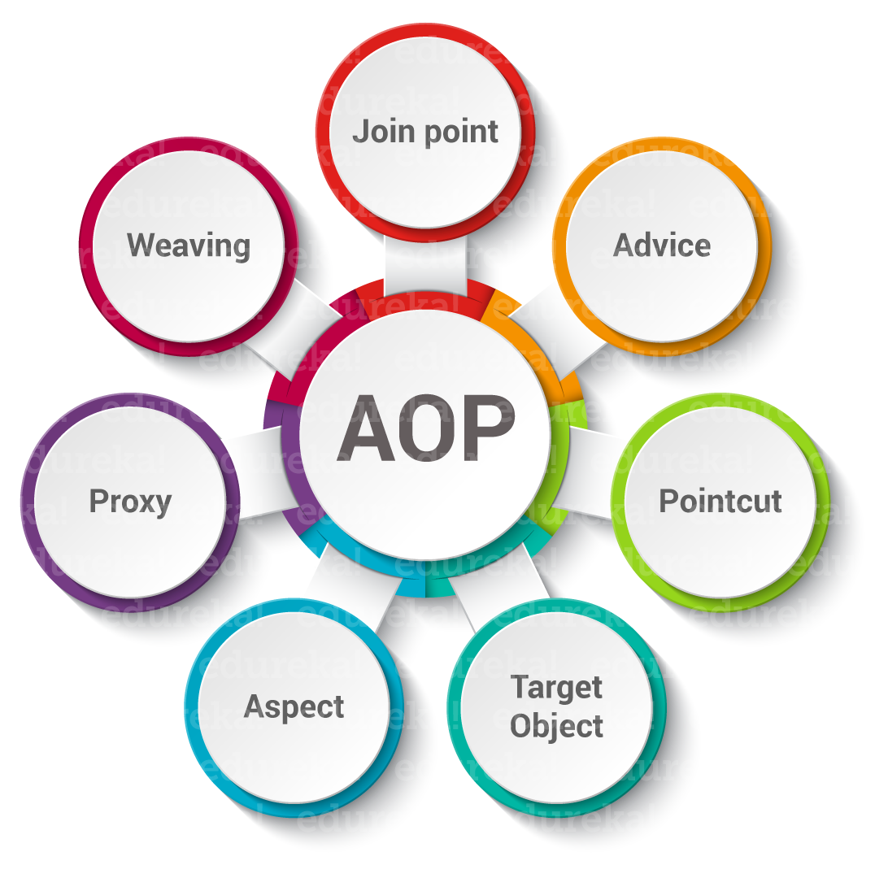
COMMON TERMINOLOGIES

Slide 6
ASPECT
The class which implements the JEE application cross-cutting concerns(transaction, logger etc) is known as the aspect.
It can be normal class configured through XML configuration or through regular classes annotated with @Aspect.
An application can have any number of aspects.
Example:
@Aspect
class Logging {
}

Slide 7
@Aspect
class Logging {
}
public class ImplementAspect {
public static void main(String args[])
{
Scanner sc = new Scanner(System.in);
System.out.println("my first aspect");
ApplicationContext ctx = new ClassPathXmlApplicationContext("beanconfigfile.XML");
ImplementAspect call = (ImplementAspect)ctx.getbean("aspect");
System.out.println("enter an integer");
int a = sc.nextInt();
if (a == 1) {
throw new RuntimeException(msg);
}
else {
call.aspectCall();
}
call.myMethod();
}

Slide 8
public void aspectCall()
{
System.out.println("Applying advices"+ " for the first time");
}
public void myMethod()
{
System.out.println("This is an"+ " extra method");
}
}

Slide 9
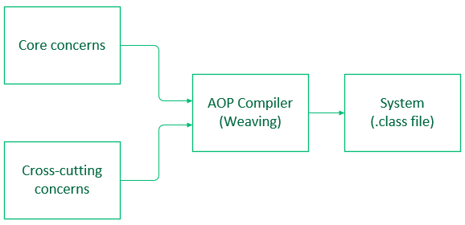
WEAVING
The process of linking Aspects with an Advised Object.
It can be done at load time, compile time or at runtime time.
Spring AOP does weaving at runtime.

Slide 10
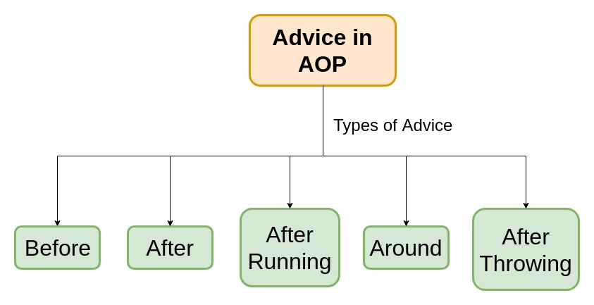
ADVICE
The job which is meant to be done by an Aspect or it can be defined as the action taken by the Aspect at a particular point.

Slide 11
Before: Runs before the advised method is invoked. It is denoted by @Before annotation.
After: Runs after the advised method completes regardless of the outcome, whether successful or not. It is denoted by @After annotation.
AfterReturning: Runs after the advised method successfully completes i.e. without any runtime exceptions. It is denoted by @AfterReturning annotation.
Around: This is the strongest advice among all the advice since it wraps around and runs before and after the advised method. This type of advice is used where we need frequent access to a method or database like- caching. It is denoted by @Around annotation.
AfterThrowing: Runs after the advised method throws a Runtime Exception. It is denoted by @AfterThrowing annotation.

Slide 12
CODE EXAMPLE:
// Program to show types of Advices
@Aspect
class Logging {
@Before("execution(public void com.aspect.ImplementAspect.aspectCall())")
public void loggingAdvice1()
{
System.out.println("Before advice is executed");
}
@After("execution(public void com.aspect.ImplementAspect.aspectCall())")
public void loggingAdvice2()
{
System.out.println("Running After Advice.");
}

Slide 13
@Around("execution(public void com.aspect.ImplementAspect.myMethod())")
public void loggingAdvice3()
{
System.out.println("Before and After invoking method myMethod");
}
@AfterThrowing("execution(" public void com.aspect.ImplementAspect.aspectCall()) ")
public void loggingAdvice4()
{
System.out.println("Exception thrown in method");
}
@AfterReturning("execution(public void com.aspect.ImplementAspect.myMethod())")
public void loggingAdvice5()
{
System.out.println("AfterReturning advice is run");
}
}

Slide 14
JOIN POINTS
An application has thousands of opportunities or points to apply Advice. These points are known as join points.
For example :
Advice can be applied at every invocation of a method or exception be thrown or at various other points.
But Spring AOP currently supports only method execution join points (advising the execution of methods on Spring beans).

Slide 15
Code Example:
@Aspect
class Logging {
@Before("execution(public void com.aspect.ImplementAspect.aspectCall())")
public void loggingAdvice1(JoinPoint joinpoint)
{
System.out.println("Before advice is executed");
System.out.println(joinpoint.toString());
}
}

Slide 16
POINT CUTS
Since it is not feasible to apply advice at every point of the code, therefore, the selected join points where advice is finally applied are known as the Pointcut.
It helps in reduction of repeating code by writing once and use at multiple points.
Often you specify these point cuts using explicit class and method names or through regular expressions that define a matching class and method name patterns.

Slide 17
Code Example:
@Aspect
class Logging {
@Pointcut("execution(public voidcom.aspect.ImplementAspect.aspectCall())")
public void pointCut()
{
}
@Before("pointcut()")
public void loggingAdvice1()
{
System.out.println("Before advice is executed");
}
}

Slide 18
TARGET OBJECT
An object on which advices are applied, is called the target object. Target objects are always a proxied It means a subclass is created at run time in which the target method is overridden, and advices are included based on their configuration.
PROXY
It is an object that is created after applying advice to a target object is called proxy. The Spring AOP implements the JDK dynamic proxy to create the proxy classes with target classes and advice invocations. These are called AOP proxy classes.

Slide 19
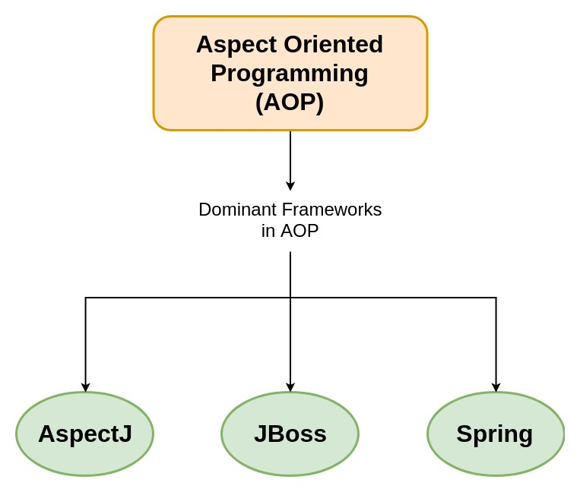
FRAMEWORKS IN AOP
AOP includes programming methods and frameworks on which modularization of code is supported and implemented.
Let’s have a look at the three dominant frameworks in AOP:

Slide 20
ASPECTJ
Extension for Java programming.
Created at PARC research centre.
It uses Java like syntax and included IDE integrations for displaying crosscutting structure.
It has its own compiler and weaver.
On using it enables the use of full AspectJ language.
Spring ships with a small AspectJ aspect library, which is available stand-alone in your distribution as spring-aspects.jar.

Slide 21

JBOSS
100% Pure Java Aspect Oriented Framework. Tightly integrated with our application server.
Aspects allow you to more easily modularize your code base.
Prepackaged set of aspects that are applied via annotations, pointcut expressions, or dynamically at runtime.
Expand the Java language in a clean pluggable way rather than using annotations solely for code generation.

Slide 22
SPRING AOP
Spring uses proxy based mechanism.
It creates a proxy Object which will wrap around the original object and will take up the advice which is relevant to the method call.
Proxy objects can be created either manually through proxy factory bean or through auto proxy configuration in the XML file.
It get destroyed when the execution completes.
Proxy objects are used to enrich the Original behaviour of the real object.

Slide 23
COMPARE AOP FRAMEWORKS
Spring AOP | AspectJ
There is a need for a separate compilation process. | It requires the AspectJ compiler.
It supports only method execution pointcuts. | It supports all pointcuts.
It can be implemented on beans managed by Spring Container. | It can be implemented on all domain objects.
It supports only method level weaving. | It can wave fields, methods, constructors, static initializers, final class, etc.

Slide 24
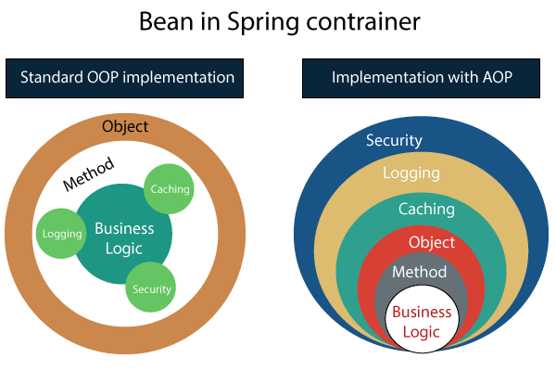
COMPARSION OF AOP AND OOP

Slide 25
AOP | OOP
Aspect: A code unit that encapsulates pointcuts, advices, and attributes. | Class: A code unit that encapsulates methods and attributes.
Pointcut: It defines the set of entry points in which advice is executed. | Method signature: It defines the entry points for the execution of method bodies.
Advice: It is an implementation of cross-cutting concerns. | Method bodies: It is an implementation of the business logic concerns.
Weaver: It constructs code (source or object) with advice. | Compiler: It converts source code to object code.

